Slide 1

ADVANCED ACCOUNTANCY - I
B. Com III – Sem - V
By CA. Sunil G Ingale

Slide 2
Topic No : 1
Insurance Claims-Loss of Stock and Profit by fire
By CA. Sunil Ingale

Slide 3













Slide 4








Slide 5
Life Insurance Companies
https://www.irdai.gov.in/ADMINCMS/cms/NormalData_Layout.aspx?page=PageNo129&mid=3.1.9
Life insurance business
General Insurance Companies
https://www.irdai.gov.in/ADMINCMS/cms/NormalData_Layout.aspx?page=PageNo264&mid=3.2.10
General Insurance Business

Slide 6
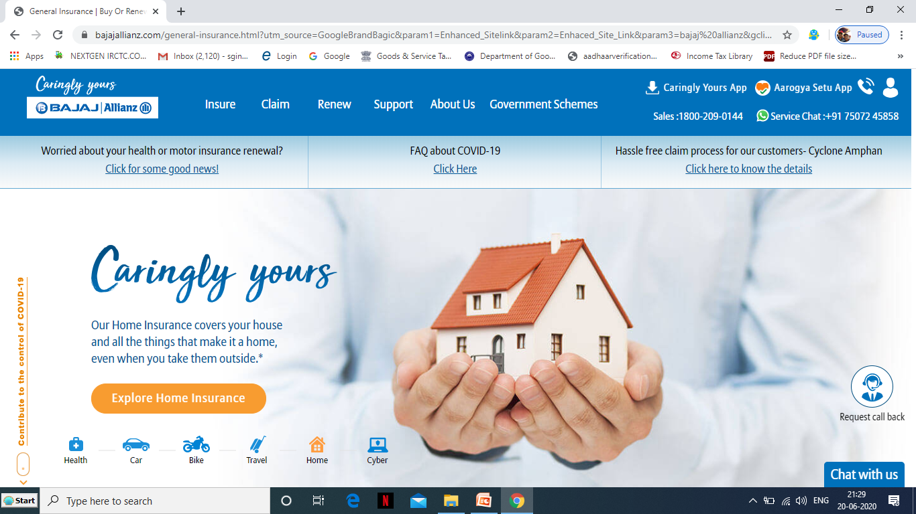

Slide 7
SECTORAL INFORMATION
The insurance industry of India consists of 60 insurance companies of which 24 are in life insurance business and 36 are non-life insurers. Among the life insurers, Life Insurance Corporation (LIC) is the sole public sector company. Apart from that, among the non-life insurers there are six public sector insurers. In addition to these, there is sole national re-insurer, namely, General Insurance Corporation of India (GIC Re). Other stakeholders in Indian Insurance market include agents (individual and corporate), brokers, surveyors and third party administrators servicing health insurance claims.
Out of 36 non-life insurance companies, five private sector insurers are registered to underwrite policies exclusively in health, personal accident and travel insurance segments. They are Star Health and Allied Insurance Company Ltd, Apollo Munich Health Insurance Company Ltd, Max Bupa Health Insurance Company Ltd, Religare Health Insurance Company Ltd and Cigna TTK Health Insurance Company Ltd. There are two more specialised insurers belonging to public sector, namely, Export Credit Guarantee Corporation of India for Credit Insurance and Agriculture Insurance Company Ltd for crop insurance.

Slide 8
INSURANCE MARKET
The Indian insurance market is a huge business opportunity waiting to be harnessed. India currently accounts for less than 1.5 per cent of the world’s total insurance premiums and about 2 per cent of the world’s life insurance premiums despite being the second most populous nation. The country is the fifteenth largest insurance market in the world in terms of premium volume, and has the potential to grow exponentially in the coming years.

Slide 9
Difference between
Life Insurance
General Insurance

Slide 10
1 : Claim for Loss of Stock
2 : Claim for Loss of Profit Policy

Slide 11
1
Insurance of
Sock-Claim for
Loss of Stock

Slide 12
Claim process
Fire takes place
Stock is destroyed
Some Stock saved
Loss is suffered
Lodge claim /(Indemnity)
Value of Stock????

Slide 13
Problems and solutions
Last Year’s Trading Account=
Find out G. P. Ratio
Current Year’s Trading Account=
Find out Stock on the date of fire
Lodge Claim with Insurance Company

Slide 14
Important Points / Concepts – Loss of Stock
Contract of Indemnity **
Policy Amount:- Maximum loss amt by Insurance Company
Percentage of Gross Profit
Valuation of Stock
Adjustments
Goods of irregular line
Stock Salvaged
Under-insurance
Average Clause
Damaged Goods / Shop Soiled Goods

Slide 15
Percentage of Gross Profit
Normal Gross Profit Ratio should
be considered
Average Percentage is to be taken
Increasing / Decreasing Trend
It is not hard and fast rule
GP Ratio = GP/Sales*100

Slide 16
Valuation of Stock
If the stock figures given in the problem
are not at cost price and Below or Above
cost , it necessary to convert them to cost
price before ascertaining the percentage of
gross profit
Valuation = At cost

Slide 17
Adjustments
Returns inwards remained unrecorded
Goods distributed as free sample
Loss of goods by theft
Purchase or sale of asset included in
purchases or sales
**Important Principle**
Trading Account is like Goods Account

Slide 18
Goods of Irregular Line /
Slow Moving Items /
Abnormal Goods
If these goods are included in the stock, purchases and sales, the Percentage of gross profit will be affected
The value of such goods included in various items must be deducted from the respective items to get value of goods of regular line
Aim➔ Find out Normal G. P. Ratio
For the Purpose of Claim = value these items at cost

Slide 19
Stock Salvaged
Value of Stock Saved from fire
It is deducted from the “Stock on the date
of fire’ and the remaining balance is
“The loss of stock due to fire”

Slide 20

DAMAGED / SHOP SOILED STOCK
To be valued at below cost i.e. at agreed value

Slide 21
Loss of stock
PLUS
Normal Stock
LESS
Slow Moving (Cost)
Shop Soiled (Reduced value)
Loss of Stock
Sock Salvaged
&

Slide 22
Under insurance
Policy Amount
Stock Value

Slide 23
Average Clause
Inserted in Policy to prevent Under-insurance
Sum Insured Loss of Stock
Claim = ---------------------------------------------------------------- * -------------------------
Total Stock on the Date of fire 1

Slide 24
2
Loss of Profit Policy

Slide 25
Fire takes place
Shop is damaged
Shop is closed
No / reduced sales
Profit is reduced
How much
How much

Slide 26
Reduction in Sales
G. P. Ratio
Reduction in Profit
Total Loss Amount
Loss of profit+ACW
Claim Amount (Average clause)
Amount for which policy should be taken
Claim amount
Additional Cost of working (ACW)

Slide 27
Important Concepts – Loss of Profit
Period of Indemnity
Period of dislocation
Standard Sales
Short Sales= Standard - Actual
Gross Profit Percentages

Slide 28
important concepts – loss of profit
Standing Charges
Additional Cost of Working
Annual Sales
Amount for which policy should be taken
Claim Amount

Slide 29
Important steps – Loss of Profit
Reduction in Profit = Short Sales * G. P Ratio
Loss of Profit = Reduction – Saving in insured
in Profit standing charge
Additional cost of working = whichever is less
  a) Sales because of ACW * G. P. Ratio
b) Net Profit + Insured Standing Charge
-------------------------------------------------------- * Additional Cost of
Net Profit + All Standing Charges Working
Total Loss Amount = Loss of + Additional cost of
Profit Working

Slide 30
Important steps – Loss of Profit
Amount for which policy should be taken = Annual Sales * G. P. Ratio
Under-insurance = Policy < Amount for which
Amount policy should be taken
Claim Amount =
Policy Amount Total Loss
-_______________________________________________________________________________________ X Amount
Amount for which policy should
be taken

Slide 31
Period of Indemnity
The period during which the sales are
expected to be affected due to fire is
stated in the policy. This period is known
as “Indemnity Period.”
Period allowed by insurance company
to restart the business normally

Slide 32
Period Of Dislocation
It is the actual period taken by the business to start normally.
It is the period taken to achieve again normal sales

Slide 33
Different concepts of sales
Standard Sales = Sales during dislocation period
in the previous year
Annual Sales = Sales for 12 months ended on the
date of fire
Sales for G. P. Ratio = Sales for completed financial year for which accounts are prepared.
Standard and annual sales need to be adjusted for any trends

Slide 34
Short Sales (Step No. 1)
Short Sale = Standard Sales (Estimated or
expected sales during
the period of dislocation)
Less : Actual sales during the dislocation
period

Slide 35
Gross Profit Percentage
(Step No. 2)
Earning or Gross Profit Ratio = for calculation
of GP Ratio figures of completed financial year
to be considered.
If there is any trend in GP ratio or adjustment
same should be applied and GP should be
increased / decreased accordingly
Net Profit + Insured Standing Charges
--------------------------------------------------------------- * 100
Sales of Last Financial Year
Standing Charges:- Fixed Expenses, Expenses which remain constant irrespective of sales / production

Slide 36
Reduction in Profit (Step No. 3)
=Short Sales * G. P. Ratio
Loss of Profit (Step No. 4)
=Reduction in Profit – Saving in insured standing charges

Slide 37
Additional Cost of Working (Step No. 5)
Expenses incurred to run the business during dislocation period
Whichever is less
Additional cost of working
Sales because of ACW * G. P. Ratio
Net Profit+ Insured Standing Charges
= ACW* -------------------------------------------------------------------
Net Profit + Total Standing Charges

Slide 38
Total Loss Amount (Step No. 6)
==Loss of profit (Step no. 4) + Additional Cost of Working (ACW) (Step No. 6)
Annual Profit (Amt. for which policy should be taken) (Step No. 7)
== Annual Sales* Gross Profit Ratio (Step No. 2)

Slide 39
Claim Amount (Step No. 8)
Annual Profit (Step No. 7)
Policy Amount
Check under-insurance
Annual Profit > Policy Amount
Average clause becomes applicable
Policy Amount
Claim Amount = Total Loss Amt* ---------------------
(Step No. 6) Annual Profit

Slide 40
The End

